Slide 1

DriverPass System Analysis
Justin Schumann
Notes:
[No speaker notes required for this slide.]

Slide 2

System Requirements
Functional Requirements:
A user can entered with their username and password to sign up to subscribe for packages, take practice tests, and sign up for online classes. And Schendel appointments for driving lessons.
The program should provide progress information such as test scores and class completion for online users.
Nonfunctional Requirements:
Online security such as encryption, and giving Admin the ability to disable suspicious users.
System should support a large number of users at once. Increase in traffic must not negative impact the system.
Notes:
[In your speaker notes, include an explanation of the different requirements you determined for DriverPass’s system. What are the functional requirements you selected to describe?. What are the nonfunctional requirements you selected to describe? Be sure to explain how these requirements meet DriverPass’s needs.]
As for the functional requirements of the system, there are two that I view as most important. The system must allow users to create an account. With this account, they could subscribe to a package, take practice tests and register for online classes. With this account they will schedule driving lessons. Users should be able to view their online progress, such as test scores and completion of registered classes.
The nonfunctional requirements, security and scalability are important. For security, encryption will be used to protect sensitive information. Suspicious activity that shows the signs of “Brute force hacking” will be notified by the admin, who will be able to know and disable the user. Any password reset will need to be approve by a admin before giving the link to the user. The link will be sent only through either a pre-existing provided email or text number. As for scalability, for the website to be successful it will need to support many users at once. The system’s infrastructure must handle large increase in workloads. Servers must in good condition, and have reliable internet connection and memory storage.

Slide 3
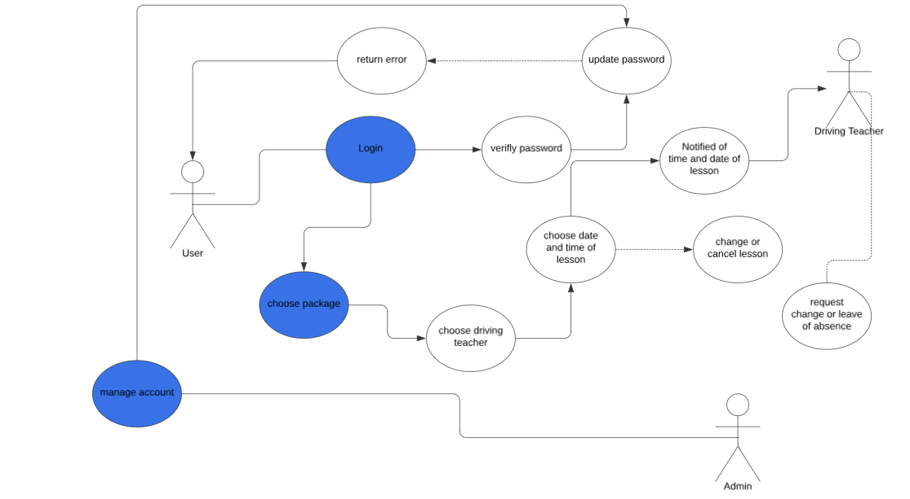
Use Case Diagram
Notes:
[Explain your diagram. Who are the different actors in the system? What are the different use cases? How did you account for DriverPass’s needs in your design? In your explanation, keep your audience in mind. Avoid the use of terms like “actors” and “use cases” in your explanation.]
The system’s actors are the user, teacher and Admin. The user logs in, chooses a package, chooses the driving teacher, and chooses the time and date of the driving lesson, and is able to update or cancel it. The driving teacher gets notified of the time and date of their student, and can request a different time or leave of absence. If leave of absence is approved, the notification goes to another driving teacher, who will take over the slot. These interactions are manage and watch over by the Admin, who can either approve or disapprove of any password change.

Slide 4
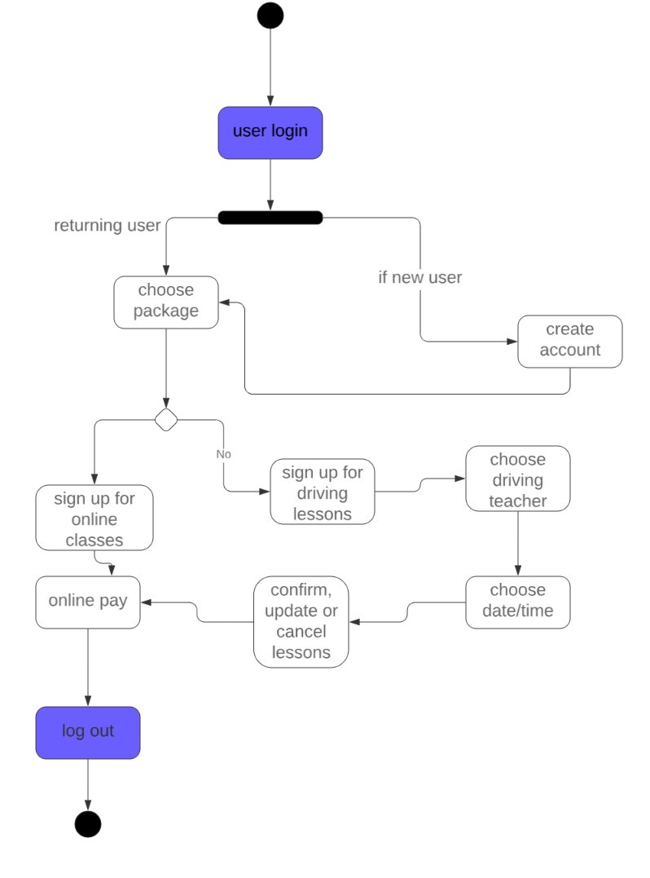
Activity Diagram
[Insert one of your activity diagrams here.]
Notes:
[Explain your diagram. Which use case are you breaking down? What are the steps for this use case? How did you account for DriverPass’s needs in your design? In your explanation, keep your audience in mind. Avoid the use of technical terms such as “nodes,” “control flows,” and so on.]
The diagram depicts a user logging in. If a user is new, they will have to create an account. If they are returning they could straight away choose their package. Whatever package they choose they could either sign up for online classes or schedule driving lessons. Either way, they must provide payment before logging out.

Slide 5
Security
[Include a bulleted list of how your design addresses security concerns.]
Users must have their email authorize before buying a package and registering.
Users must login with a password with seven characters or more.
Information will be sent encrypted. This will be done by HTTPS.
Password reset will be approve by Admin before sending link.
Notes:
[How did you consider security in your design? In your explanation, keep your audience in mind by avoiding the use of technical terms.]
Any user will need to provide a verified email before creating an account for packages. Users will need to create a password with at least seven characters. Users will need to reset their password
If you put it incorrectly four times, this helps to prevent unauthorized users such as hackers.
The system’s data will be encrypted to prevent it being read by unauthorized users. The data will be converted from plaintext to cyphertext. That way, any unauthorized must guess what key and cipher in order to read it.
Password change requests would need to be approved by the website’s administration. The link will not be sent through the website, making it harder for cybertheft. The link will instead be sent by either email or text number, which has already been provided by the users when creating their account.

Slide 6
System Limitations
[Include a bulleted list describing the limitations of your system.]
Users using older not up to date devices might have issues using the website.
The client might not have the number of stuff needed to meet user demand.
Users in regions with slow internet might have difficultly using the website.
Notes:
[What are the limitations of your design? In your explanation, keep your audience in mind by avoiding the use of technical terms.]
Firstly, using a decades old device that is not up to standard may cause issues when using the website. A website with modern software may not be comparable with a device of outdated hardware. Using the website with such hardware, could lead to slow performance and crashes. Secondly, things like tech support, Admin, online teachers, driving instructors require stuff. The client might not have enough people to meet user demand, leading to a waiting list and issues maintaining the website. Thirdly, not every region has up to date internet access, especially in rural and low income areas, where internet infrastructure hasn’t been in good shape.

